Slide 1
SCHOOL INTEGRATION
Then & Now

Slide 2
Plessy v. Ferguson
1896
Supreme Court decision made it legal to separate people by race in public spaces, including schools
“Separate but equal”
At the bus station in Durham, North Carolina 1940

Slide 3
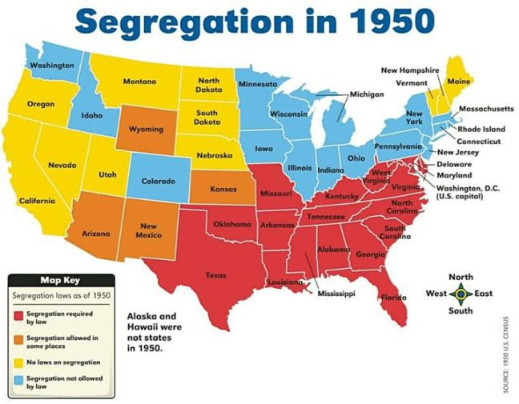
17 states + DC had segregation laws
16 states had laws banning segregation
4 states allowed local government to make laws about segregation
11 states had no laws about segregation
Segregation in the United States, 1950

Slide 4
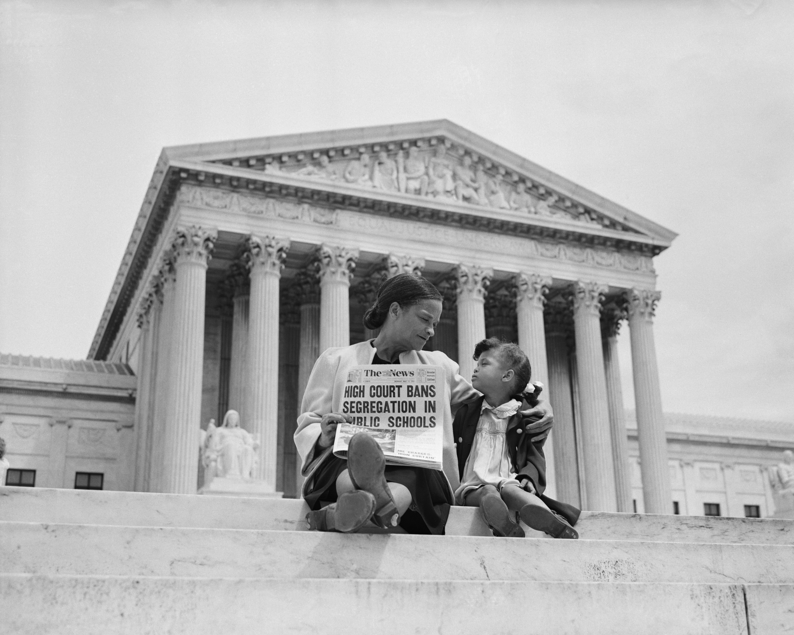
Brown v. Board
1954
Supreme Court decided it was not legal to separate children in schools by the color of their skin
Mrs. Nettie Hunt explaining to her daughter Nikie the meaning of the Supreme Court's decision banning school segregation, 1954

Slide 5
WHAT HAPPENED NEXT?
The Brown v Board decision required all US schools to integrate.
How do you imagine school integration worked?
What were some of the challenges? Why did these challenges exist?
How much time would it take to integrate schools?
Discuss with a partner. Be prepared to share.

Slide 6
Segregation in the United States after Brown v Board, 1958

Slide 7
PHOTO ANALYSIS
In groups, analyze your assigned photo by finishing the following thoughts:
I see…
I think…
I wonder…

Slide 8
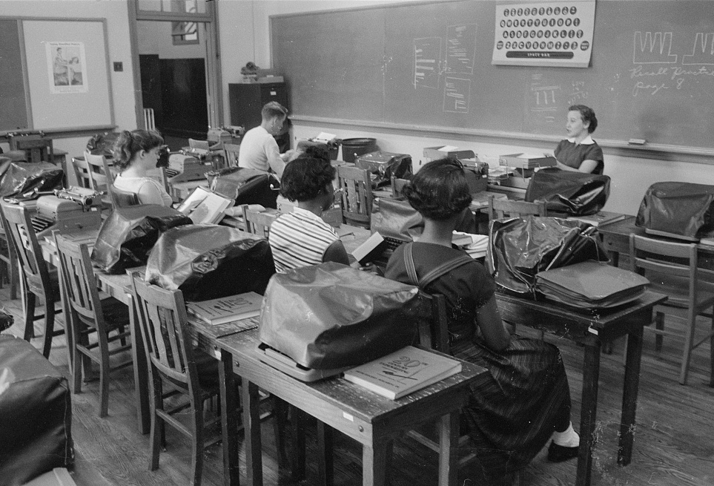
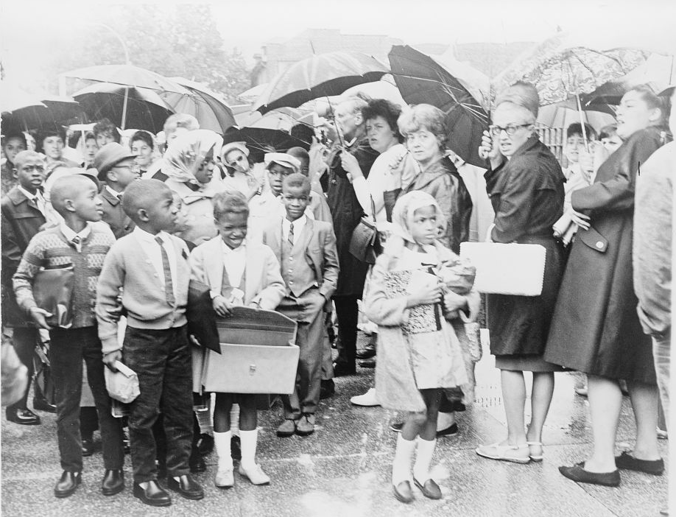
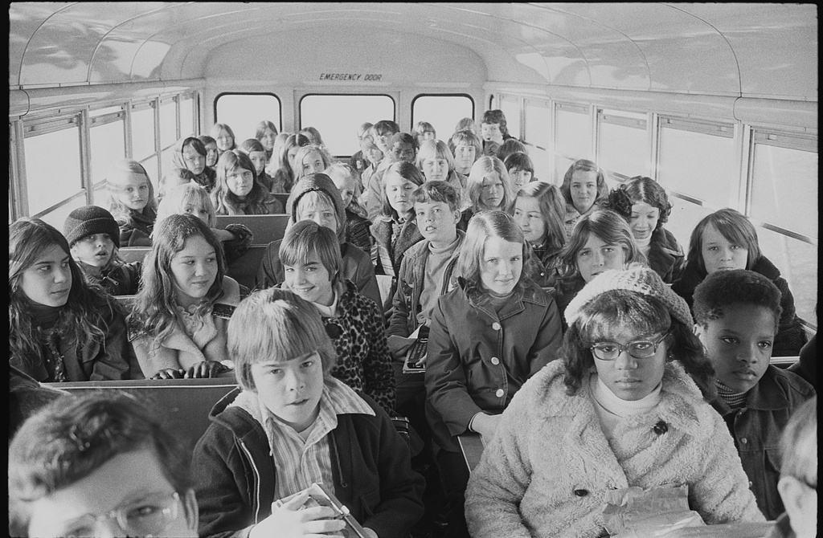
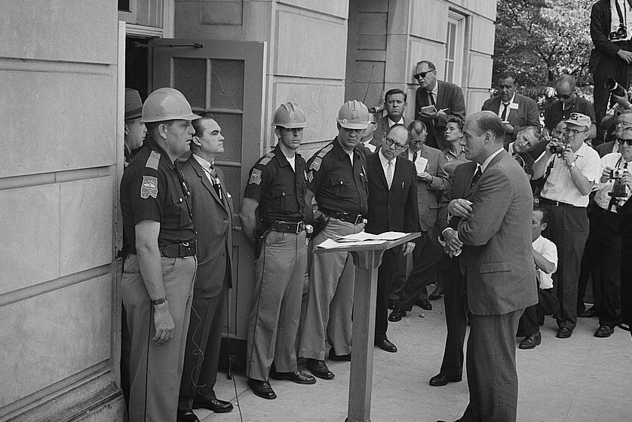
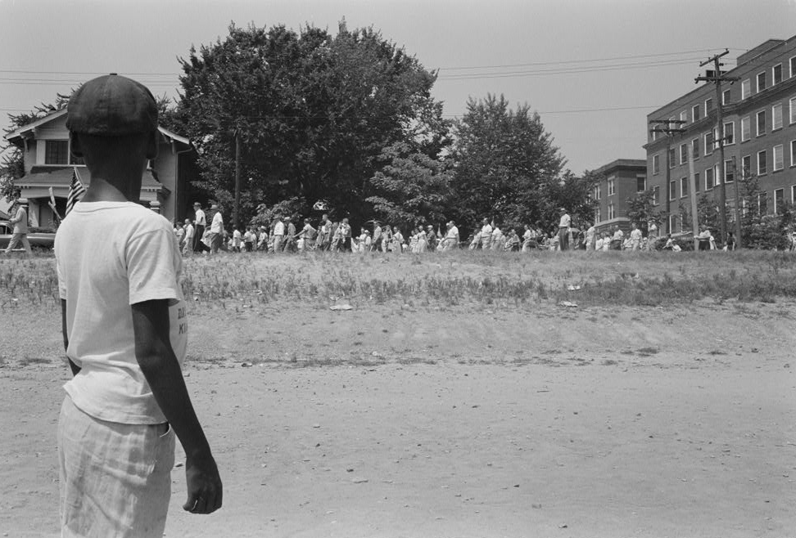
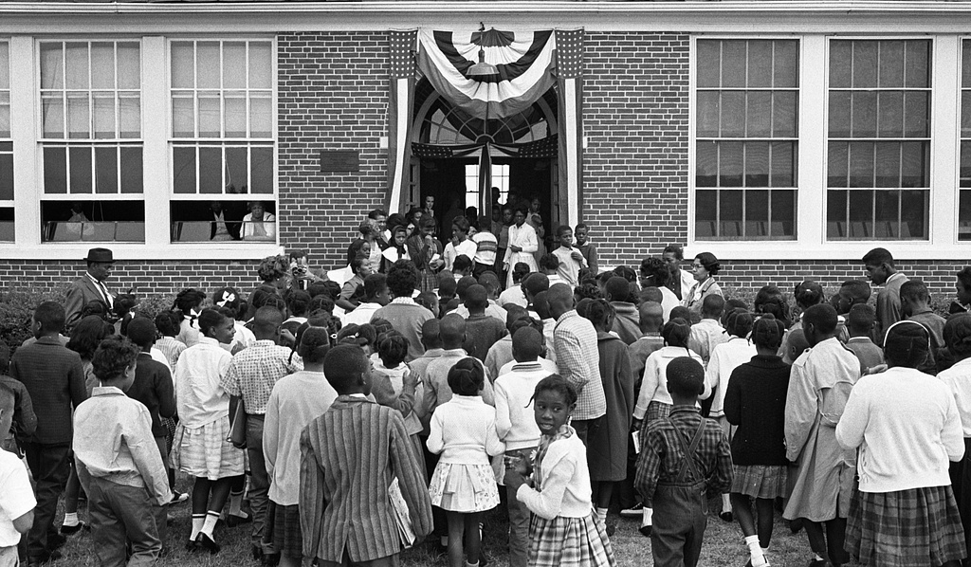
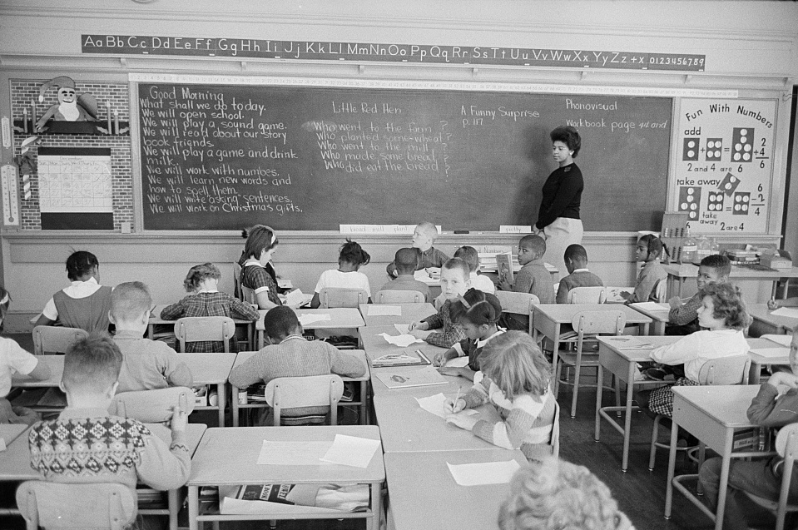
E
F
G
A
B
C
D

Slide 9
PHOTO ANALYSIS
In your groups, work together to predict the chronological order of all 7 photos.
What information helps you figure out when the photo was taken?
What information do you need in order to be sure?

Slide 10
1986 Plessy v. Ferguson
1954 Brown v. Board of Education of Topeka, KS
1956 Clinton, TN
The Supreme Court said it was fair to have separate public spaces for black and white people because they were equal. This picture shows a sign at the Greyhound bus station.
This Supreme Court decision made it illegal to separate children in schools by the color of their skin.
12 African American students planned to attend high school in Clinton, TN. There were protests about integrating the school. The National Guard was brought in.

Slide 11
1963 Alabama
1964 Prince Edward County, VA
Governor George Wallace of Alabama blocks entrance into University of Alabama because he did not want integration.
This photo was taken 10 years after the US Supreme Court banned segregation and shows a class of both black and white students.
1959 Little Rock, AR
An African American boy watches a crowd of people marching to Central High School in Arkansas. They were marching to protest against black students going to Central High School.

Slide 12
1964 Washington, DC
Black students re-enter public schools in Farmville, Virginia. For nearly 5 years, no public schools were available to black students.
1968 Green v. County School Board of New Kent County, VA
Supreme Court decided the 'freedom of choice' plan did not integrate schools. The photo shows white mothers protesting black students who were being bussed to the all-white school.
1971 Swan v. Charlotte-Mecklenburg Board of Education
Supreme Court decides that busses can be used to integrate schools. To make sure schools are integrated, students could be bussed to schools outside their neighborhood.

Slide 13
EXAMINE THE TIMELINE
What is the same about these events? What is different?
What changes have happened because of the Brown v. Board of Education Supreme Court decision?
How does each photo show support or resistance to school integration?
15 years after the Brown v. Board decision, did people accept school integration? What do you see in the photos that helps you know?

Slide 14
HOW DOES CHANGE HAPPEN?
What did people do to make the change to integrate schools?

Slide 15
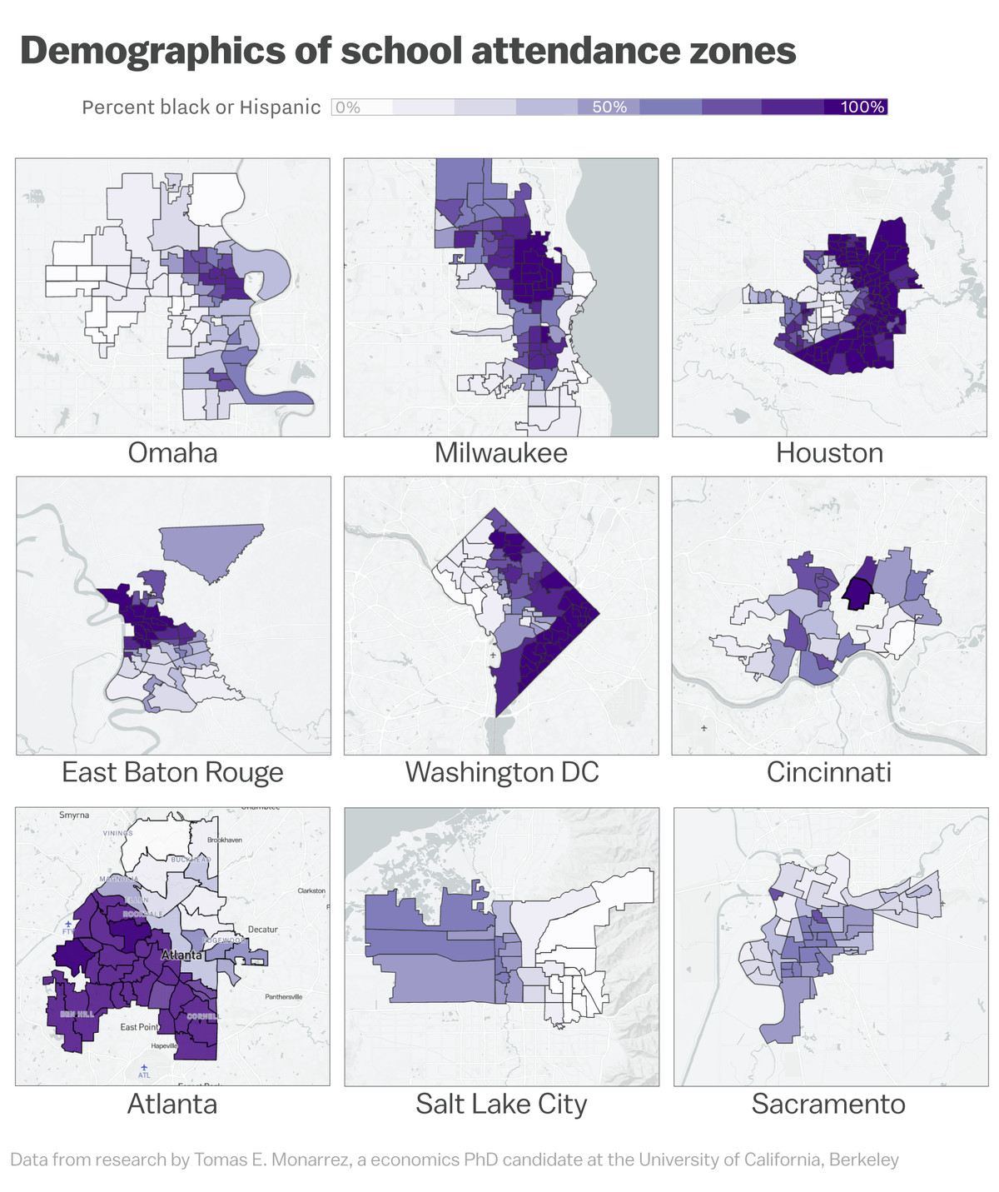
When did segregation end?
Does segregation still exist?
How do you know?
Schools in the United States Today

Slide 16
HOW FAR HAVE WE COME?
Are we better off today? Why or why not?
Have we changed enough? How do we know?
How do we know when change is necessary?

Slide 17
CREDITS
Inquiry in the Upper Midwest
Project Director
Kathryn Stower
Project Coordinators
Kara Knight, Jennifer Cadwell-Vaughan
Master Teacher, Writer
Kellie Friend
Funded by a generous grant from the Library of Congress

